Slide 1

CONFERENCE ATTENDANCE REQUEST (car) guide
May 2024

Slide 2

OBJECTIVES
• Become familiar with current travel policies. • Become familiar with travel forms.
• Know where to access supporting justification for travel activities.
• Have sufficient knowledge to complete and submit timely and accurate travel forms.

Slide 3


Slide 4
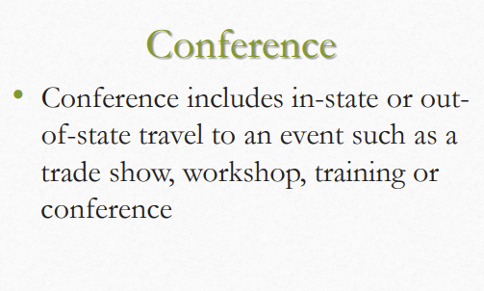
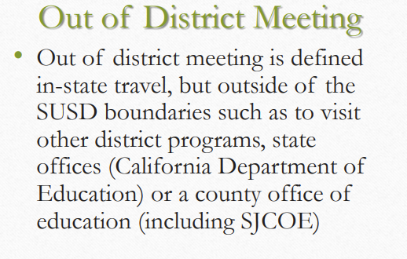
Conference vs. Out-of-District Meeting

Slide 5
Out-of-State Travel
• Per Board Policy 3350, adopted 3/24/15, Board approval will be required for all out-of-state travel for which reimbursement will be claimed.
• Conference Attendance Requests (CARs) for out-of-state travel will not be processed without the required approval by the Governing Board

Slide 6
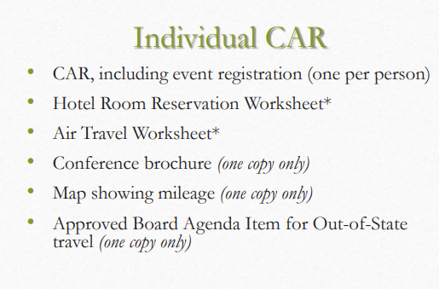
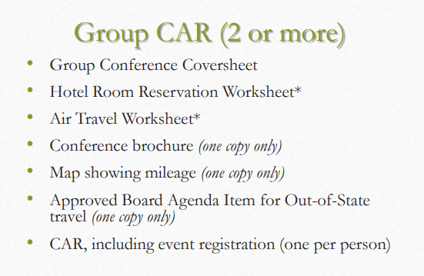
CAR Packet

Slide 7
Important Facts About CARs
Important Facts:
• All SUSD employees, parents, and volunteers must submit a CAR
• The CAR is the mechanism to obtain approval prior to attending a conference
• CARs are to be submitted to Assistant Superintendent for signature
• CARs are to be submitted at least 45 days in advance of conference

Slide 8


Slide 9
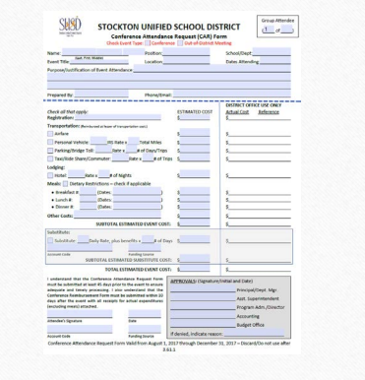
Conference Attendance Request (CAR) Form

Slide 10
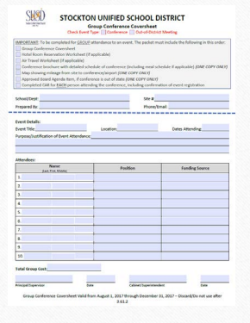
Group Conference Coversheet

Slide 11
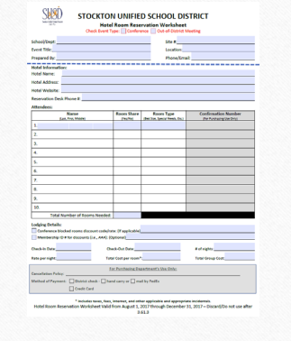
Hotel Room Reservation Worksheet

Slide 12
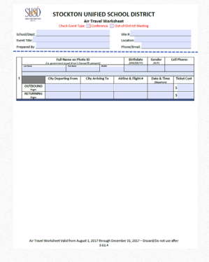
Air Travel Worksheet

Slide 13
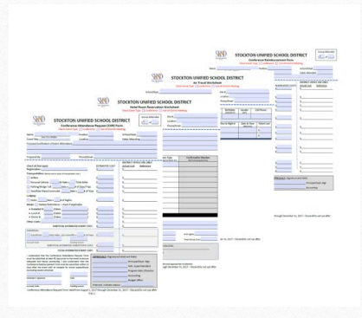
Individual CAR Packet

Slide 14
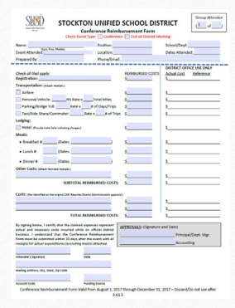
Conference Reimbursement Form

Slide 15
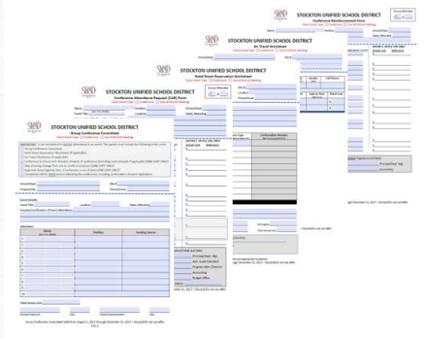
Group CAR Packet

Slide 16


Slide 17
Preliminary Travel Preparation
• Check your budget for available funds
• Have funds already been encumbered for other travel expenditures
• Is a budget transfer needed?
• Gather conference/training information
• Check for location, including travel and lodging
• Check for dates, including if substitutes/coverage is needed
• Check for included incidentals, such as breakfast or lunch provided
• Check for group rates and early registration
• Gather preliminary attendee information
• Who is going
• What are their travel needs

Slide 18
Overview of CAR Completion
• General Information:
• Enter attendee and event information
• Registration:
• Register for event, include confirmation with the CAR
• Transportation:
• Identify travel needs
• Complete Air Travel Worksheet if flying
• Print out map of mileage using Google Maps
• Obtain supporting evidence of parking, shuttle fares to/from destination

Slide 19
Overview of CAR Completion – cont’d
• Lodging:
• Identify lodging needs, if not identified in the brochure, print out estimate of hotel.
• DO NOT BOOK or HOLD HOTEL ROOM USING PERSONAL CREDIT/DEBIT CARDS.
• Meals:
• Identify meal needs, review travel policy for meal allowability
• Other Costs:
• Identify other costs necessary, estimate a reasonable cost for conference-related materials

Slide 20
Overview of CAR Completion – cont’d
• Substitute:
• Identify if substitute coverage expenses are necessary
• Funding:
• Insert account code (ensure funds are available in the budget)
• Insert funding source
• Signatures:
• Obtain attendee signature
• Obtain Principal/Supervisor signature

Slide 21
Overview of CAR Completion – cont’d
• Group Travel:
• If part of a group, at the top right of the form indicate the attendee’s number within the group of attendees
• Routing:
• Route to Assistant Superintendent

Slide 22


Slide 23
Event Registration – Online
Conference Registration – Sites are to register attendee(s) to the conference
• Online registration – If a payment is required when registering online, choose one of the five payment types (in order identified below, as registration permits):
1. Bill me later
2. Purchase Order
3. Check
4. Credit card ONLY
5. Mail-in registration ONLY

Slide 24
Event Registration – Internal Processing
Bill me later – an invoice will be sent to the attendee(s) or to the person registering
Purchase Order – enter “PO TO FOLLOW” if a PO number is needed to complete the registration
Check – enter “CHECK TO FOLLOW” if a check number is needed to complete the registration. Print the registration confirmation(s) and/or invoice(s) and attach to the CAR(s). It should show the information/registration number(s) and the payment instructions. Purchasing will process the requisition for the payment (PO or check) when the approved CAR(s) is/are received.
Credit card ONLY – If none of the above payment types are acceptable and the registration payment is by credit card ONLY, print and completely fill out the registration form(s) and attach to the CAR(s). Purchasing will register the attendee(s) online using the District credit card when the approved CAR(s) is/are received. Confirmation(s) will then be forwarded to the attendee(s).
Mail-in registration ONLY – Print and completely fill out the registration form(s) and attach to the CAR(s). Purchasing will process the requisition for the check and Accounts Payable will mail the check payment along with the registration form(s) to the vendor.

Slide 25
Transportation
TRANSPORTATION – Choose the most appropriate method of travel to and from the event. The mode of transportation will be determined based on the least expensive method. Carpooling is strongly encouraged.
Air Travel – Complete the Air Travel Worksheet and attach to the CAR(s). Attendee’s legal name MUST MATCH the government issued identification, i.e., Driver’s License/ID, Passport
Personal Vehicle – Calculate mileage to/from the conference or to/from airport, if travel by air to the conference and attach a map printout to the CAR(s).
Other Expenses – Calculate/estimate parking, taxi, ride share, commuter, and bridge toll
*Other Costs – Calculate baggage fees and list them in the Other Costs section on the CAR.

Slide 26
Transportation - Air Travel
• Air travel is authorized when is determined that air transportation is advantageous to the conduct of District business. The most economical air travel must be used, including the use of discounted and special rates.
• The Air Travel Worksheet must be completed, attached to the Conference Attendance Request, and forwarded for approval.
• Ticket cost estimates may be determined by referencing online ticketing services such as www.southwest.com, www.kayak.com, and www.hotwire.com

Slide 27
Transportation - Air Travel – cont’d
• Upon receipt of the completed CAR, the Purchasing Department will purchase tickets in accordance with the policies outlined below. Purchasing will contact the originator in the event that alternate flights must be used or the actual ticket price exceeds the estimate by more than $50.
• The CAR must be submitted to Purchasing no later than 21 days prior to departure. It’s the responsibility of the principal or department head to ensure that the CAR is submitted prior to the deadline.
• Failure to submit the CAR prior to the 21-day deadline may result in unnecessary and excessive travel costs that will be charged to the originating school or department.

Slide 28
Transportation - Air Travel – cont’d
• Charges for classes of service other than economy (e.g., Business or First Class) are considered privileged and ineligible except when travel in such classes would result in overall transportation cost savings.
• In an effort to minimize air travel costs, the following options will be considered and utilized:
• Connecting versus nonstop flights
• Departing earlier or later compared to the preferred departure time
• Utilizing alternative airports
• Utilizing alternative cities
• Utilizing discount, low cost airlines
• Exploring alternative arrival and/or departure dates

Slide 29
Transportation - Air Travel – cont’d
• To the extent permitted by law and rules of each airline, any frequent mileage, bonus points or premiums---such as discounts on future fares received as a result of travel on official District business---accrues to the District.
IMPORTANT NOTE:
• Cancelling flights and changing itineraries or flight times after tickets have been purchased is strongly discouraged because it results in excessive costs to the District.
• Please attempt to limit such modifications to instances of illness or emergency only.
• Please notify your site administrator in such cases.
• Any costs for such modifications will be the responsibility of the originating school or department.

Slide 30
Meals
• Employees may not claim meals provided by the state, meals included in hotel expenses or conference fees, meals included in transportation costs such as airline tickets, or meals that are otherwise provided.
• You can find additional information regarding travel expenses on Board Policy 3350.

Slide 31
Meals – First Day of Travel
• First day of travel
• Trip begins at or before 6:00 am - Breakfast may be claimed
• Trip begins at or before 11:00 am - Lunch may be claimed
• Trip begins at or before 5:00 pm - Dinner may be claimed

Slide 32
Meals – Continuing After 24 Hours
• Continuing after 24 hours
• Trip ends at or after 8:00 am - Breakfast may be claimed
• Trip ends at or after 2:00 pm - Lunch may be claimed
• Trip ends at or after 7:00 pm - Dinner may be claimed

Slide 33
Meals – Factional Day of Travel
FOR TRAVEL LASTING LESS THAN 24 HOURS
Employees may claim breakfast and/or dinner, based on the following timeframes:
• Fractional day of travel
• Trip begins at or before 6:00 am and ends at or after 9:00 am - Breakfast may be claimed
• Trip begins at or before 4:00 pm and ends at or after 7:00 pm –
Dinner may be claimed

Slide 34
Changes to Attendees
• If the site(s) deemed it necessary to replace an attendee(s) to a conference, a new CAR packet is required to be completed for the replacement(s).
• Indicate on the top margin of the CAR who the person is replacing.
• Submit the CAR(s) for approvals.
• Notify Purchasing of the replacement.

Slide 35
Cancellations
Important Facts:
• Immediate notification to Accounts Payable and Purchasing of any cancellation(s).
• Site budgets are responsible for any penalties and/or non-refundable expenditures incurred. Such costs will be charged to the account(s) on the CAR(s).
• Registration
  The site is responsible for cancelling registration to an event.
  Notify Accounts Payable and Purchasing of the cancellation.

Slide 36
Cancellation (cont’d)
• Lodging
  Hotel room reservation(s) must be cancelled prior to the hotel cancellation deadline to avoid a penalty. Contact Purchasing by phone to cancel the reservation(s).
  If unable to contact, attendee may cancel the reservation(s) and forward the cancellation confirmation(s) to Purchasing and Accounts Payable.
• Air travel
  Contact Purchasing by phone at least 24 hours prior to the flight.
  If unable to contact, the attendee(s) may cancel the flight reservation(s) and forward the cancellation confirmation(s) to Purchasing

Slide 37
Reimbursement of Travel Expenses
•Submit Conference Reimbursement forms no later than ten days after the conference.
• Attach a copy (preferably an approved copy) of the Conference Attendance Request form.
• Attach original receipts, if any, and a copy of the hotel folio showing the room charges for the time stayed and the amount the District paid. (This should net to zero.)

Slide 38


Slide 39
BP 3350 – Travel Expenses
• “The Governing Board shall authorize payment for actual expenses, including travel, incurred by any employee performing authorized services for the District.
• Reimbursement rates are noted below:
  Meal/Lodging Per Diem Allowance
a. Per U.S. General Services Administration (GSA) website by City, State, or Out of Country (for Current Year)
  2. Mileage Allowance
  a. Per rate established by Internal Revenue Service (IRS) website (for Current Year)

Slide 40
BP 3350 – Travel Expenses – cont’d
• Travel by air will be prepaid by the District.
• Travel by car will be reimbursed based upon actual miles traveled.
• Vehicles should be shared whenever possible to minimize travel costs.
• No employee shall be entitled to reimbursement for automobile travel when he/she is offered District transportation, transported free of charge, or transported by another employee who is entitled to expense reimbursement.
• Employees shall make every effort to minimize the cost of expenses to the District and consider, when possible, taxi sharing, carpooling, or other available expense- saving measures.

Slide 41
BP 3350 – Travel Expenses – cont’d
• The District shall not reimburse personal travel expenses.
• Personal travel expenses may include, but are not limited to:
• Alcohol
• Entertainment
• Laundry
• Expense for family members who are accompanying the employee on District-related business
• Personal use of automobiles, and
• Personal losses or traffic violation fees incurred while on District business

Slide 42
BP 3350 – Travel Expenses – cont’d
• The Board must approve, in advance, any conference or travel expenses for non employees (students, residents, volunteers) as “representatives of the Board.”
• The Superintendent or designee shall establish procedures for the submission and verification of expense claims. He/she may authorize an advance of funds to cover necessary expenses.”

Slide 43


Slide 44
Leaving SUSD Employment
• Management reserves the right to approve or disapprove conference requests of staff members who are scheduled to either retire from the district or leave for other employment.
• We must be prudent in our efforts to protect the district’s resources and use our resources only for the training of those staff members who will be continuing to work in our district.

Slide 45
THANK YOU!

